Slide 1

INTRODUCTION TO MICROECONOMICS
Presented by,
Md.Ishrak Khan (20101051)
Shahriar Ahmed (22241145)
Rifha Hossain Munaja (20301466)
Sadab Sifar (23341064)
Kazi Shahed Mamun (20301471)
A Comparative Market Analysis

Slide 2
Why NIKE and Adidas?
NIKE:
Nike is an American company operating within the sports apparel market that was founded in the year 1964. Nike Inc is one of the top sports footwear and accessories designers in the world, controlling a market share of 20% of the global athletic market.
Adidas:
Adidas is a multinational company that was founded in 1949 in Germany and specialized in sports apparel within the free global market. The current operating income of the company is 1.202 billion Euros, with total equity of 5.489 billion Euros.
Both of these companies stock sports balls, bags, and eyewear, footwear, and sports shoes for adults and children and are taken as substitute of each other.

Slide 3
Price elasticity of Nike products (Nike sneakers/jersey)
Nike’s products are price elastic since they are categorized as luxury goods. For instance, the demand for the luxury Nike jersey product is very sensitive to price changes since potential customers can do without the product when it is considered too expensive.

Slide 4
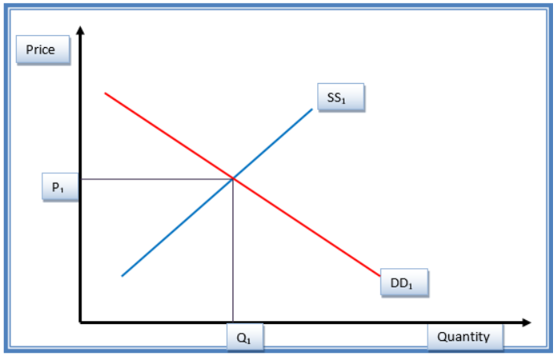
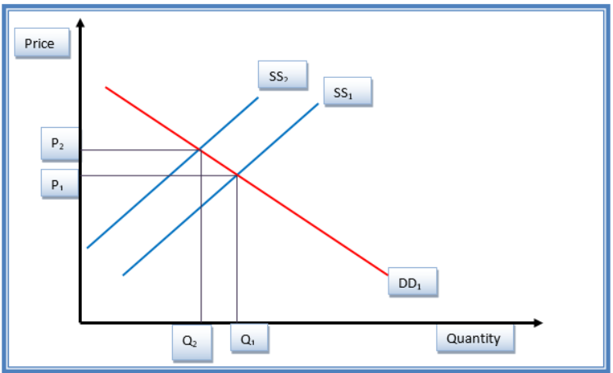
Fig. 1.1: Demand and supply of Nike products before changes in the price.
This shows the initial equilibrium status of the Nike products before the changes in the price. DD1 shows the demand curve, while SS1 shows the supply curve (Guru 48). Equilibrium price and quantity are P1 and Q1, respectively.
Fig. 1.2: Demand and supply of Nike products after changes in the price.
An increase in the price of Nike jersey with other perfect substitute products such as Adidas jersey causes an inward shift of the supply curve from SS1 to SS2, as indicated in figure 1.2. This gives a new equilibrium position. Price increased from P1 to P2 (Mankiw 56). This indicates reduced demand from the customers. The net effect of the increase in price is a contraction of the demand side. The price elasticity for Nike jersey product is pre-calculated at 0.7 (McEachern 23).

Slide 5
Price elasticity of Adidas products (Adidas sneakers/jersey)
Adidas’ products are also priced elastic since they are categorized as luxury goods. The demand for Adidas jersey product is sensitive to price changes since potential customers can do without the luxury product when it is considered too expensive.

Slide 6
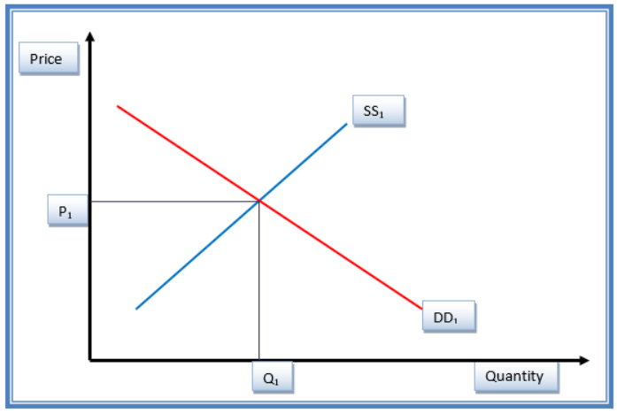
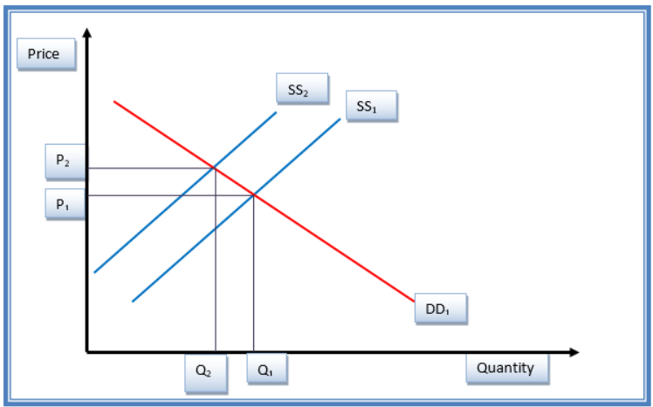
Fig. 3: Demand and supply of Adidas products before changes in the price.
Figure 3 shows the initial equilibrium status of the Adidas products before the changes in the price. DD1 shows the demand curve, while SS1 shows the supply curve. Equilibrium price and quantity are P1 and Q1, respectively.
Fig. 4: Demand and supply of Adidas products after changes in the price.
An increase in the price of Adidas jersey with other perfect substitute products such causes an inward shift of the supply curve from SS1 to SS2, as indicated in figure 4. This gives a new equilibrium position. Price increased from P1 to P2. The price elasticity for Adidas jersey product is pre-calculated at 0.5 (Sexton 19).

Slide 7
Income elasticity of Nike products (Nike sneakers/jersey)
Nike jersey is a luxury product, which is income elastic. When income of a household increases, the demand for Nike jersey will increase. This leads to outward shift in the demand curve for product from D0 to D1 and a new equilibrium is achieved at point E1 with price P1 and a higher quantity Q1. Conversely, when income reduces, individuals’ disposable incomes reduce (Guru 48). Given that Nike product is a luxury commodity, the demand will decline, resulting in the drop of quantity of products demanded. The corresponding price will fall from the initial P0 to P2. A new equilibrium will be achieved at point E2. The income elasticity of Nike jersey is pre-determined at 0.5 (McEachern 33).

Slide 8
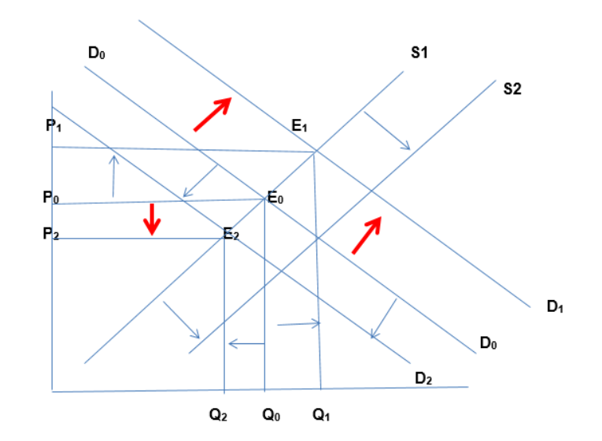
Fig. 1.3: Income elasticity changes Nike product.
Fig. 1.3: Income elasticity changes Nike product.

Slide 9
Income elasticity of Adidas products (Adidas sneakers/jersey)
Since Adidas jersey is a luxury product, it is income elastic. That is, an increased income of a household would translate into more demand for the product since the household will have more disposable income to purchase the product. The reverse is also true. For instance, when the income of a household increases, the demand for Adidas jersey will increase. This leads to an outward shift in the demand curve for a product from D0 to D1, and a new equilibrium is achieved at point E1 with price P1 and a higher quantity Q1. Conversely, when income reduces, individuals’ disposable incomes reduce (Guru 51). Given that Adidas products are luxury commodity, the demand will decline, resulting in the drop of quantity of products demanded. The income elasticity of Adidas jersey is pre-determined at 0.4 (Mankiw 29).The corresponding price will fall from the initial P0 to P2. A new equilibrium will be achieved at point E2.

Slide 10
Fig. 1.3: Income elasticity changes Nike product.
Fig. 1.4: Income elasticity changes Adidas product.

Slide 11
Cross Price Elasticity
The cross elasticity is an economic concept that measures the responsiveness in the quantity demanded of one good when the price for another good changes.
Basically, Nike, Adidas, and major players in this oligopolistic market have similar income elasticity behavior since the luxury products are the same and within similar price range. For increase, an increase in price of Nike jersey by 5% will result in an increase in demand for Adidas jersey by 10%, meaning that the cross price elasticity for these two substitutes and other products in the same category is 2 (Sexton 19; Mishra 39).
The cross price elasticity of demand between the products of Nike and Adidas and competing products is 2 since market conditions are constant for all the players in the sports apparel industry (McEachern 54). However, Nike has higher price elasticity of 0.7 and income elasticity of 0.5 as compared to 0.5 and 0.4 respectively for Adidas. This means that Nike has higher price and income elasticity that Adidas.

Slide 12
Conclusion
The analysis of the sports apparel market shows how Nike and Adidas' acts are influenced by economic factors. Both businesses show price elasticity as luxury brands with a reputation for quality due to their responsive demand patterns in the face of price changes. The Nike and Adidas jerseys serve as an example of income elasticity, where demand rises in response to rising household incomes and declines in response to economic crises, altering demand curves and equilibrium states as a result. Cross-price elasticity emphasizes their functions as commodities that are interchangeable with one another, where changes in the price of one item affect the attraction of the other. Although there are a few parallels in income elasticity, there are also subtle differences, with Nike showing stronger price and income elasticity. This interaction illustrates the complex balance between economic factors and customer behavior in the world of expensive sports clothing. Nike and Adidas navigate these dynamics as competitors while maintaining individualistic features.

Slide 13
References
Guru, Simon. “Main Factors which Determines the Price Elasticity of Demand for a Commodity.” The Quarterly Journal of Economics, 9.18(2015): 47–77. Print.
Mankiw, Gregory. Principles of Economics, Volume 1. Alabama, Al: Cengage Learning, 2008. Print.
McEachern, William. Economics: A Contemporary Introduction. Alabama, Al: Cengage Learning, 2011. Print.
Mishra, Rajan. Industrial Economics and Management Principles. New York, NY: Firewall Media, 2008. Print.
Sexton, Roberts. Exploring Economics. Alabama, Al: Cengage Learning, 2015. Print.

Slide 14
Thank You

